Slide 1
LeadrBoard - Restaurant Ranking App
Group Number - 3
Student Ids
Tushar Chavan - 10552610
Shrivardhan Limbkar - 10573876
Bijendra Gaur - 10525552

Slide 2
Overview
The newly arrived travelers of a city who wants to identify the top Restaurants, Bars & Clubs of the city, the “LeadrBoard” is a mobile app that provides ease to identify the top Restaurants, Bars & Clubs unlike the app “XYZ” that has paid rankings our app provides the unbiased ranking to Restaurant, Bars & Clubs depending on user’s feedback and preferably the user’s friends.

Slide 3
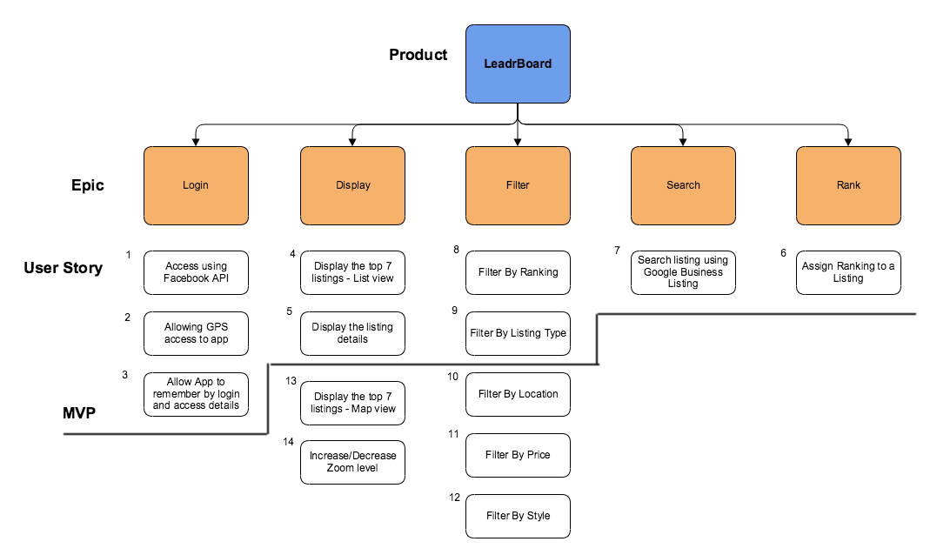
Scope of the System

Slide 4
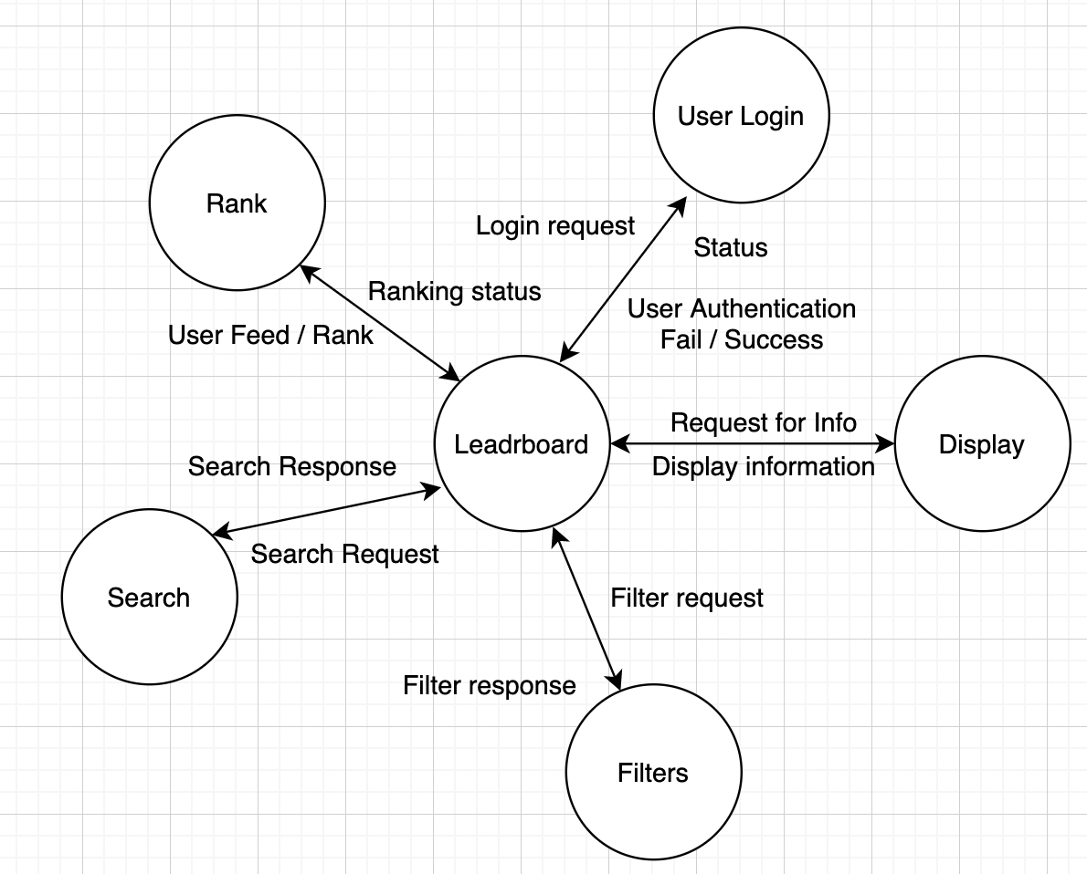
Context Model

